Slide 1
Facial Recognition using Eigenfaces
Mohini Patel(A20434107)
Krishna Yeolekar (A20429706)

Slide 2
What?
Face is a complex multidimensional visual model
A methodology for face recognition based on information theory approach of coding and decoding the face image
Classifying a face either “known” or “unknown”, after comparing it with stored known individuals.

Slide 3
Why?
Applications of Face Recognition
Security
Trueface.AI – Fraud detection
Kairos – Fraud detection
Walmart – Shoplifting prevention
Healthcare
AiCure – Medication adherence
AiCure – Medication adherence
Marketing
FaceDeals – Target marketing
Notes:
https://www.techemergence.com/facial-recognition-applications/

Slide 4
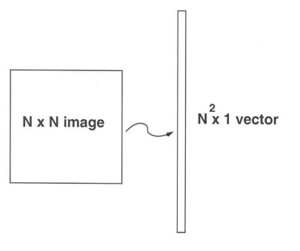
How?
Using Eigenfaces
Face recognition using eigenfaces is thinking it as a template matching problem.
Developed in 1991 by M.Turk
Based on Principal Component Analysis (PCA)
Relatively simple
Fast
Robust

Slide 5
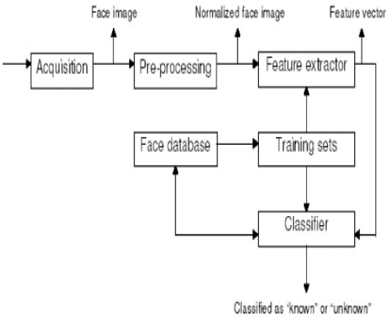
Proposed Approach

Slide 6
Eigenfaces Approach
Pattern recognition scheme that does not depend on excessive geometry and computations like deformable templates.
Eigenfaces approach seemed to be an adequate method to be used in face recognition due to its simplicity, speed and learning capability.
Eigenfaces are a set of eigenvectors used in the computer vision problem of human face recognition.
Appearance-based approach to face recognition that seeks to capture the variation in a collection of face images and use this information to encode and compare images of individual faces in a holistic manner.

Slide 7
Eigenfaces Approach
Specifically, the eigenfaces are the principal components of a distribution of faces, or equivalently, the eigenvectors of the covariance matrix of the set of face images, where an image with N x N pixels is considered a point (or vector) in N2-dimensional space .
Eigenfaces are mostly used to:
• Extract the relevant facial information, which may or may not be directly related to human intuition of face features such as the eyes, nose, and lips. One way to do so is to capture the statistical variation between face images.
• Represent face images efficiently. To reduce the computation and space complexity, each face image can be represented using a small number of dimensions.

Slide 8
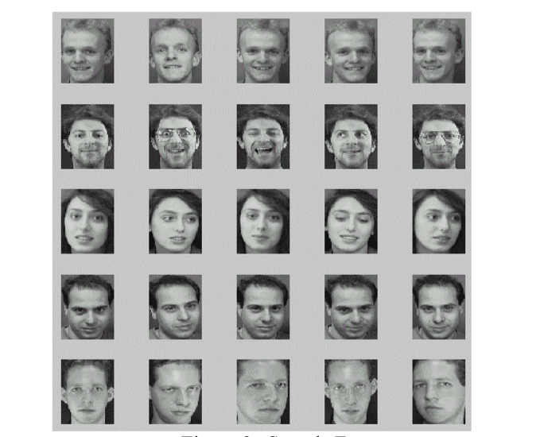
Visual representation
Represents every image in our training set as some linear combination of weights of eigenfaces which the is basis for our training set.
Figure: Sample Faces

Slide 9
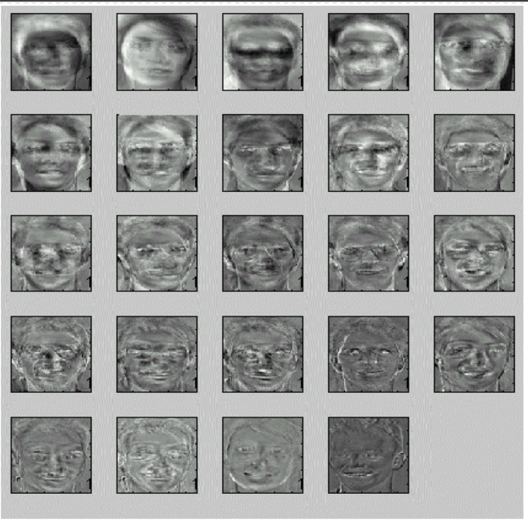
Visual representation
These calculated weights are used to represent the image in smaller subspace.
Thereafter, for recognizing the test image we calculate the weights of the test image and compare it with weights of all the images in training dataset, and recognize the image with least error between weights of test and training set.
Figure: Eigenfaces for Sample faces

Slide 10
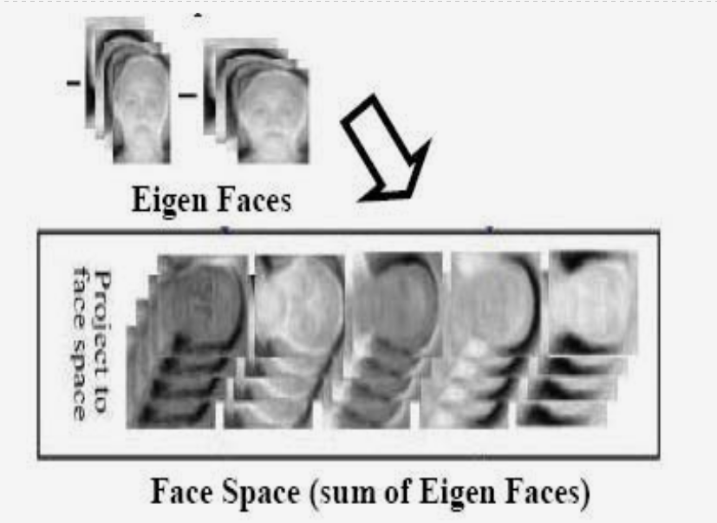
Visual representation
Figure : Describes about Eigen Faces

Slide 11
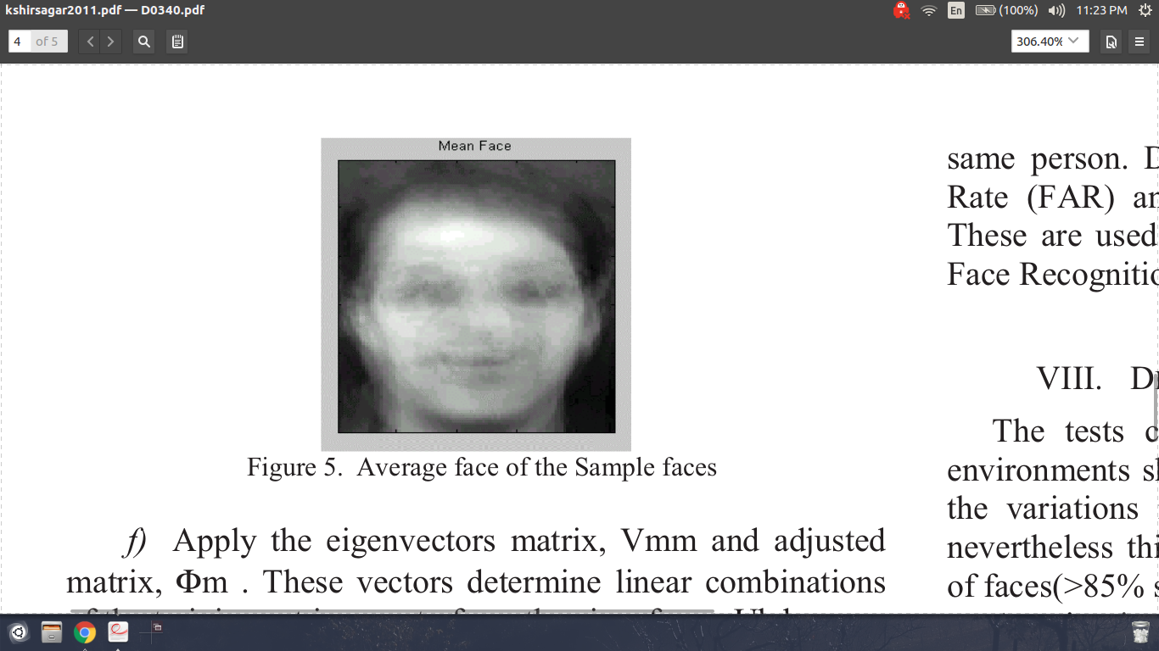
Visual representation
Figure : Average face of the sample faces

Slide 12
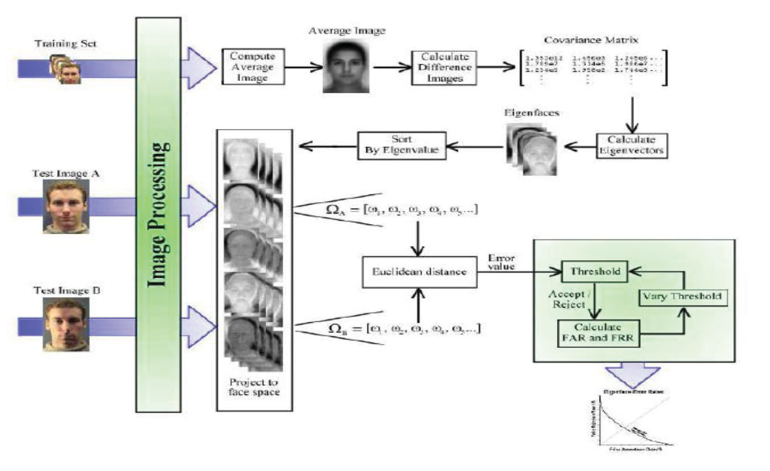
Visual representation
Figure : Complete face recognition system

Slide 13

Demo

Slide 14
Results & Analysis
Number of Eigenvectors | Accuracy
2 | 75%
3 | 87.5%
5 | 93.75%
7 | 93.75%

Slide 15
Results & Analysis
Accuracy increases as you increase the number of eigenvectors. At eigenvectors ≥ 10 image is recognized correctly and accuracy remains more or less the same.
Another observation is that as you train with more number of images it is likely that convergence point will go up as you will need more eigenvectors.
For example, when the number of test images were changed from 15 to 60 the accuracy was less than 80% with 7 eigenvectors. But when the eigenvectors were increased from 7 to 10, the accuracy increased to more than 90%.

Slide 16
Limitations of the approach
Sensitive to images with uncontrolled illumination conditions.
Limitations over variations in light, size and in the head orientation, nevertheless, this method showed very good classifications of faces(>85% success rate).
Noisy image or partially occluded face would cause recognition performance to degrade.

Slide 17
Conclusion
Dimensionality problems are solved for face recognition.
Despite the limitations the eigenfaces has proven the capability to provide the significant features.
Using Eigenfaces and PCA is quite robust in the treatment of face images with varied facial expressions is in consideration.

Slide 18
Thank You

